Slide 1

PayTrack : Expenditure Tracker
Aditya Kate - 23107126 Tanmay Harmalkar - 23107099
Roshan Ahire - 23107094
Abdullah Khan - 23107119
Project Guide
Ms.Rajashri Chaudhari

Slide 2
Contents
Introduction
Objectives
Scope
Features / Functionality
Project Outcomes
Technology Stack

Slide 3
1. Introduction
Efficient Employee Payment Management: The payroll system automates the calculation of employee salaries, Allowance, and deductions.
Compliance and Reporting
Problem Identification for a Payroll System
1. Manual Calculation Errors
2. Time-Consuming
3. Lack of Data Security
4. Compliance Issues

Slide 4
Continue..
Proposed Solution for a PayTrack System Using Java:
1.Automated Payroll Calculation
2.Employee Management Module
4.Deduction & Allowance Calculation
5.Generates Reports of Salary Slips, Staff Information & Deduction/Allowance

Slide 5
2. Objectives
The objectives of an PayTrack System include:
Accuracy in Payroll Processing: To Ensure precise calculation of employee wages, deductions and benefits, minimizing errors and discrepancies in payment.
Time and Cost Efficiency: To automate payroll tasks to reduce manual effort, save time, and lower administrative costs associated with payroll management.
Compliance with Regulations: To maintain compliance with labor regulations, and other legal requirements to avoid penalties and legal issues.
Employee Satisfaction:To Provide timely and transparent payroll processing, ensuring employees receive their wages on time and can access detailed payslips.
Data Security and Confidentiality: To safeguard sensitive employee payroll information from unauthorized access through secure data handling and storage.

Slide 6
Continue..
5.Easy Reporting and Record-Keeping: To generate payroll reports for management, audits, and government filings, ensuring all payroll-related data is easily accessible and organized

Slide 7
3. Scope
The Employee PayTrack System project:
Can be applied in:
Medium, and Large Enterprises
Government Organizations
Educational Institutions
Healthcare Facilities
Can be useful for:
1.HR Departments
2.Finance and Accounting Teams
3.Business Owners

Slide 8
4. Features
The system uses a MySQL for you to store your registered data.
2. When entering in Gross field, the system will automatically calculate the other expenses.
3. In registering a data, the user must provide a valid employee name.
4. The system also can calculate the over time by entering a specific hours in the field.

Slide 9
5.Outcome of Project
1. Payroll Calculation - Run Payroll: Based on approved attendance data, salary structure, and deductions, the system calculates net pay for each employee.
2. Payslip Generation - Generate Payslips: Create detailed payslips showing gross salary, deductions, and net pay for each employee.

Slide 10
6. Technology Stack
This Java-based expense management system features a GUI for easy budgeting.
It utilizes MySQL for data storage, automatically calculating expenses and potential payments based on gross input, designed for simplicity and skill development in Java programming.
When the Data is entered, it will automatically calculate all the other expenses and possible payable.

Slide 11
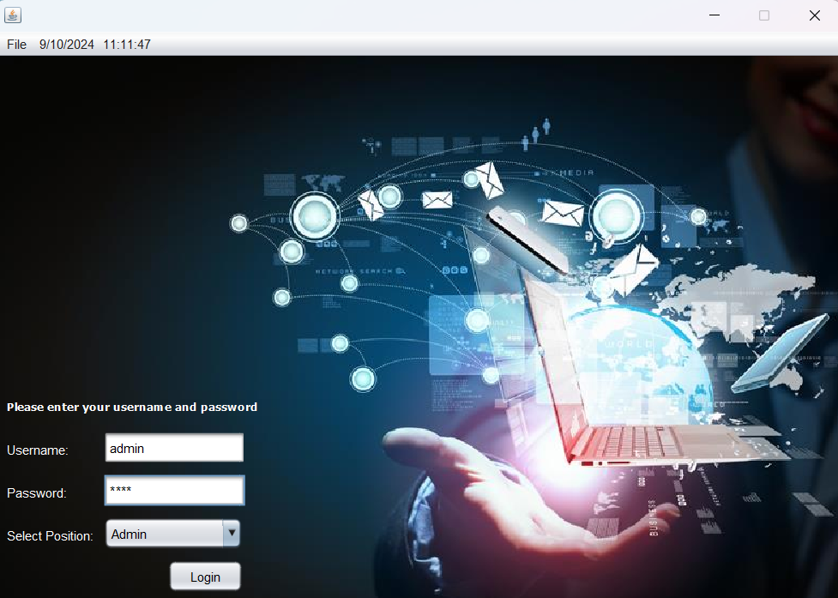

Slide 12
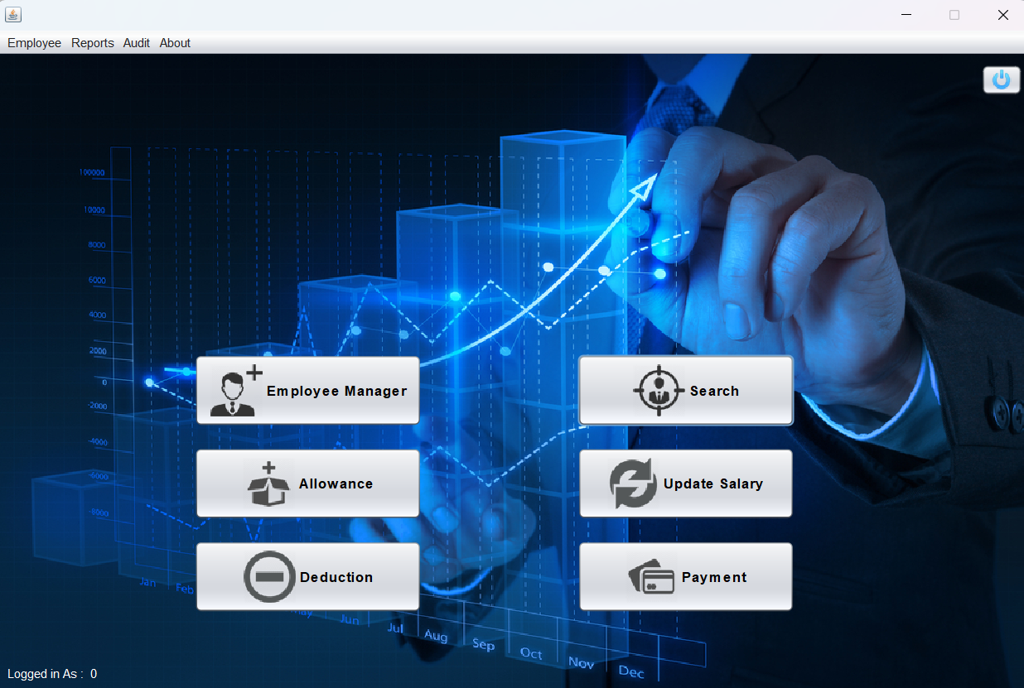

Slide 13
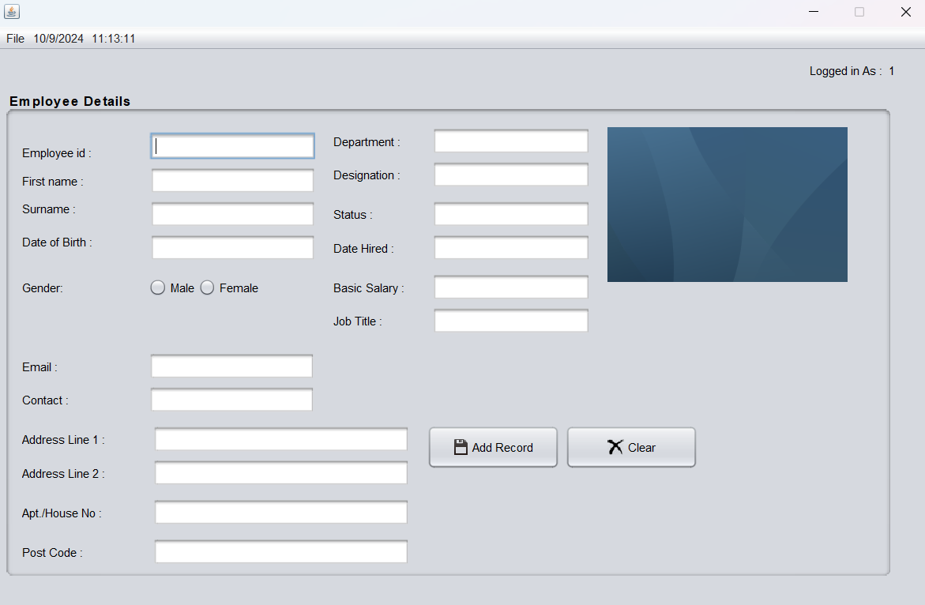

Slide 14
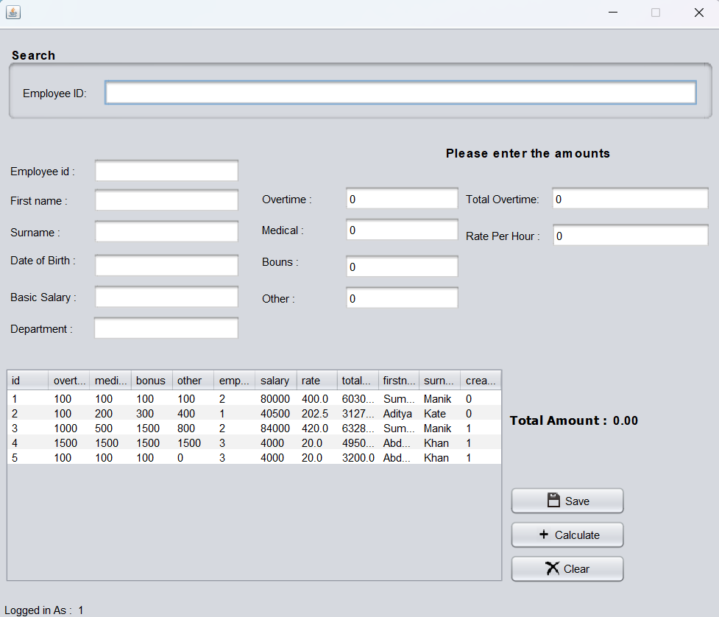

Slide 15
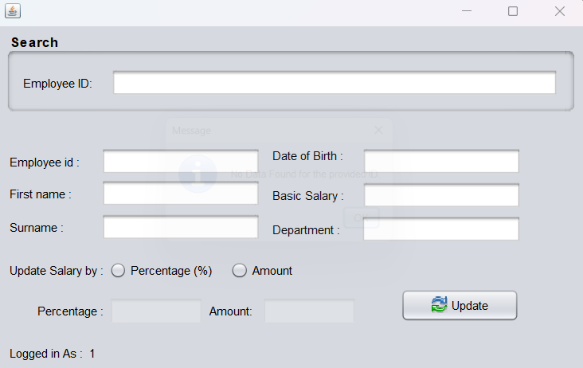

Slide 16
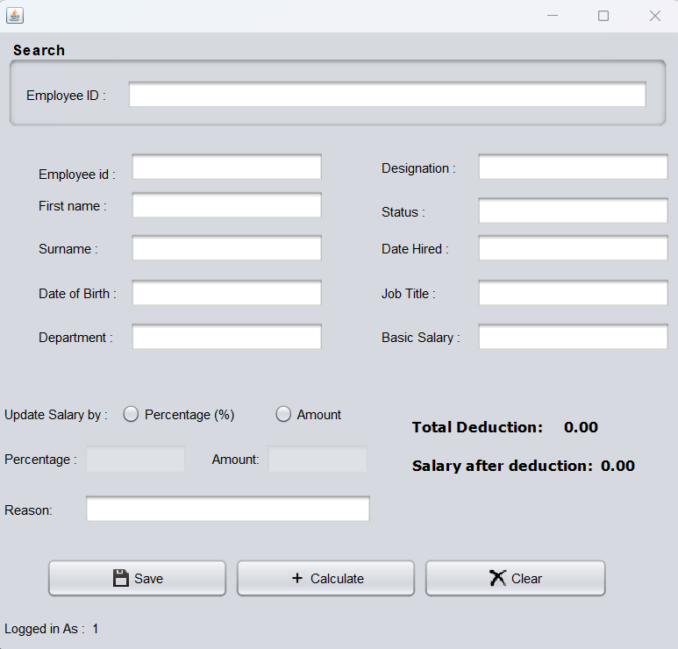

Slide 17
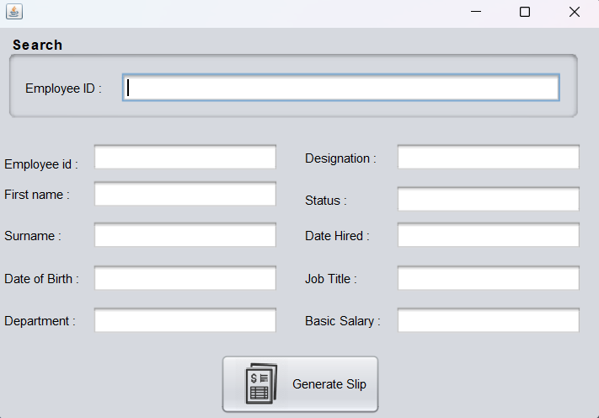

Slide 18
Thank You...!!

